Slide 1
Direction of the project
Type 2 Diabetes
Models not used in clinic
Under-investigated
National statistics clean
Manuscript underway
Cardiovascular disease
Models used in clinic
Over-investigated
National statistics ?
Extra work to rewrite

Slide 2
No prognostic T2D models adopted in the US (while there are elsewhere, e.g. UK)
But this will change, and US will adopt prognostic T2D models for 3 key reasons:
Big data + AI will make prediction better
CVD models have been successful
T2D is very expensive
So we will examine the current most likely
candidate models for adoption in primary care,
and see that they xxxxx (e.g. not equitable)
And we recommend/flag that in developing/adopting new models,
xxxxx are important considerations,
e.g. fairness, equitable..

Slide 3
Major changes since a week ago
Cumulative incidences recalculated (sum)
Imputation re-done (15 copies)
NHANES variance estimation implemented
Error bars calculated for estimates
Narrowed down to 3 models (Framingham, ARIC, San Antonio)
Descriptive table created
Work on the manuscript (Background, Methods, Results)

Slide 4
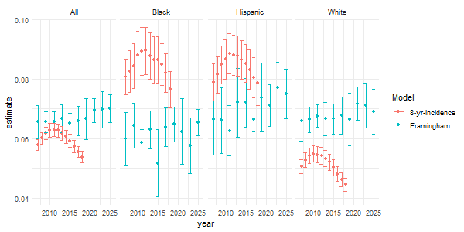
Framingham

Slide 5
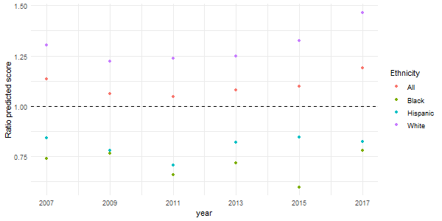
Framingham – ratio of predicted/real-life

Slide 6
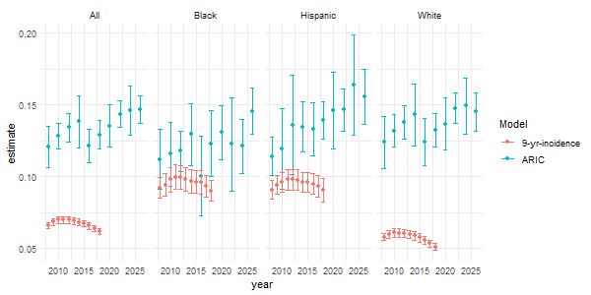
ARIC

Slide 7
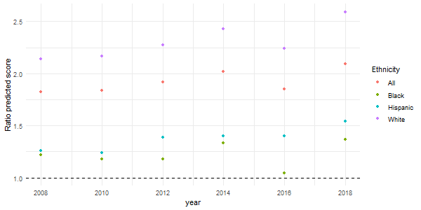
ARIC – ratio of predicted/real-life

Slide 8
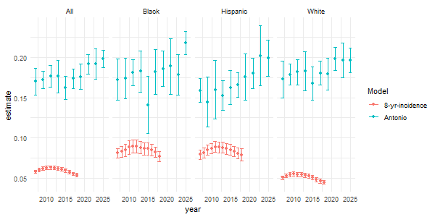
San Antonio

Slide 9
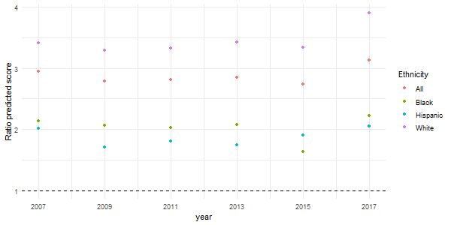
San Antonio – ratio of predicted/real-life

